Slide 1
Caravel FPGA Lab 3 Implement -Axilite access GPIO pins
Ian Liu

Slide 2
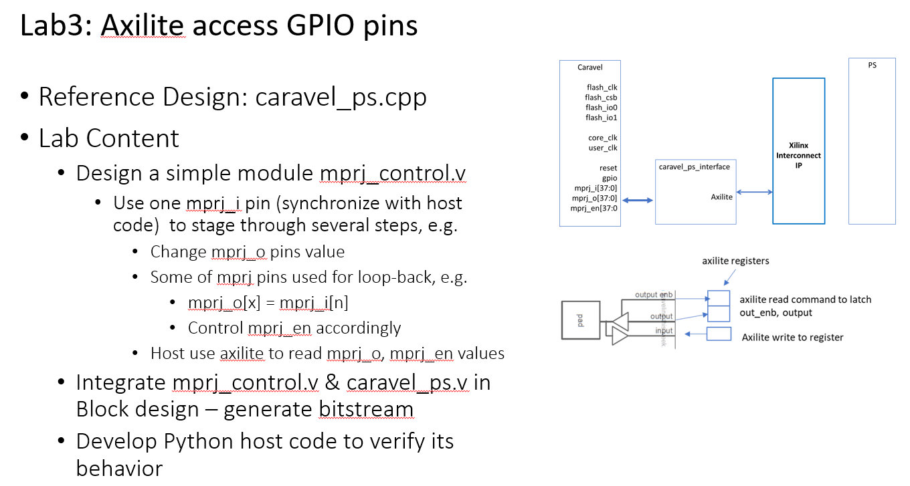

Slide 3
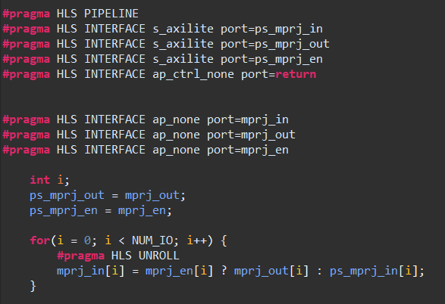
Caravel_ps.cpp

Slide 4
mprj_control.v
mprj_i[36] =1 ->> mprj_o = mprj_i
=0 ->> mprj_o = 0x1234
mprj_i[37] =1 ->> mprj_en[35:0] = 0xfffffffff
=0 ->> mprj_en[35:0] = 0x0

Slide 5
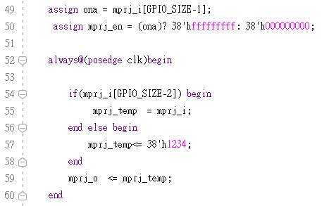
mprj_control.v

Slide 6
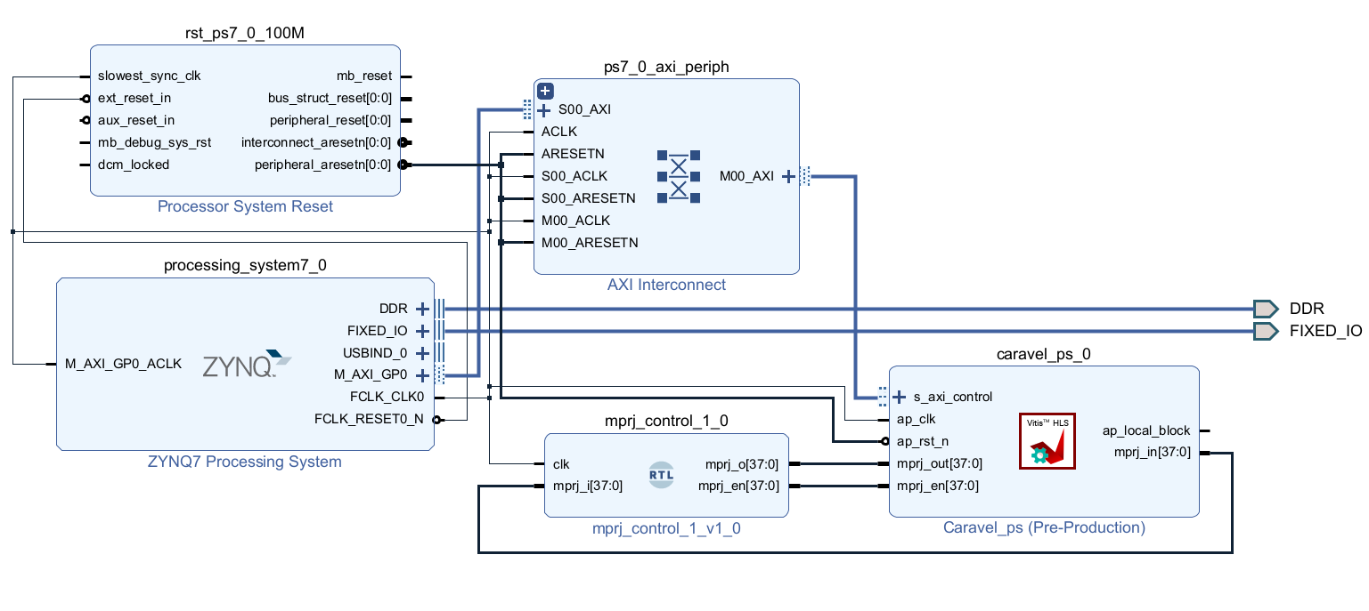

Slide 7
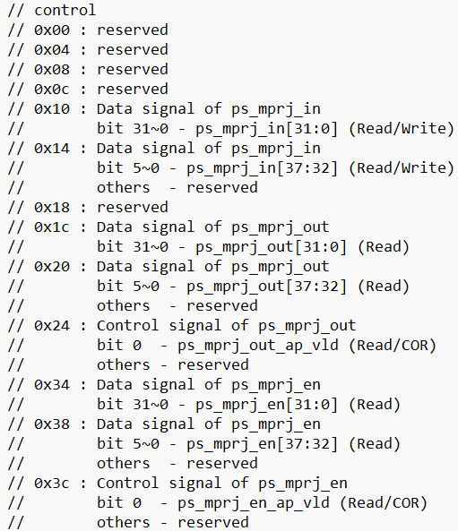
Axilite register

Slide 8
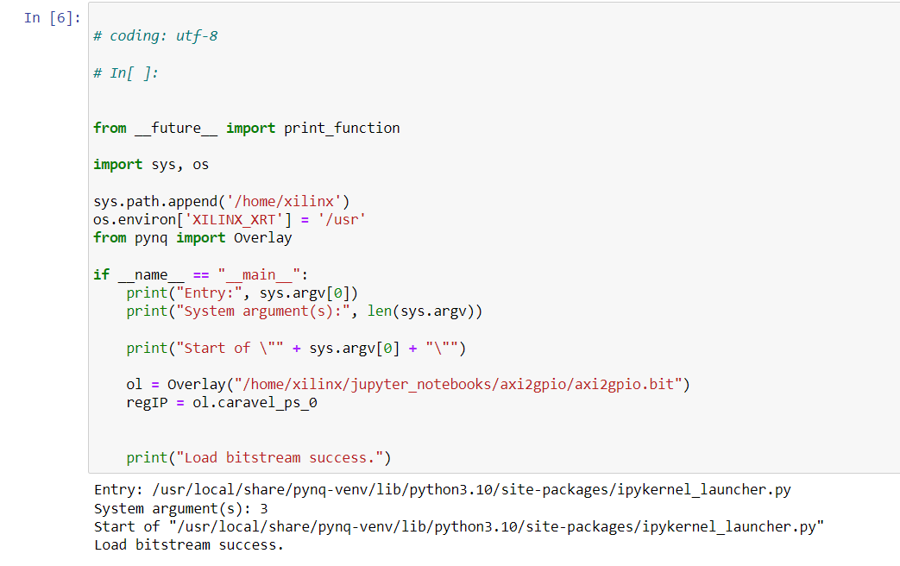

Slide 9
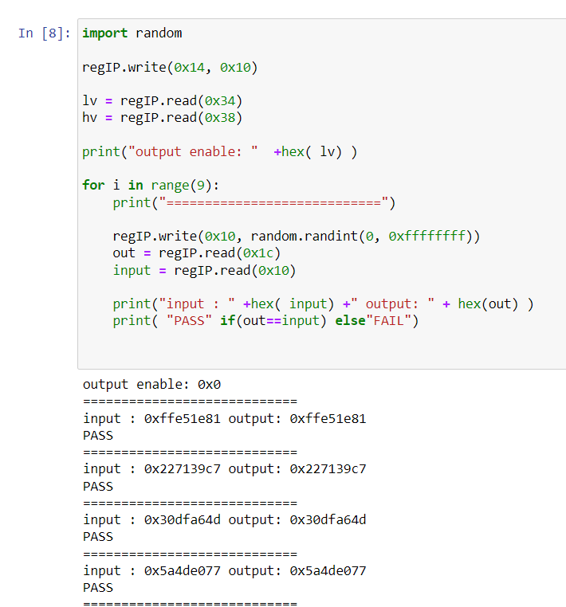

Slide 10
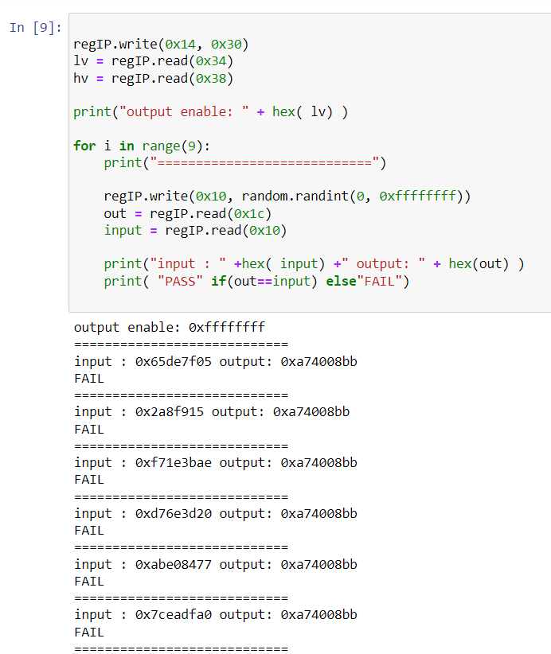

Slide 11
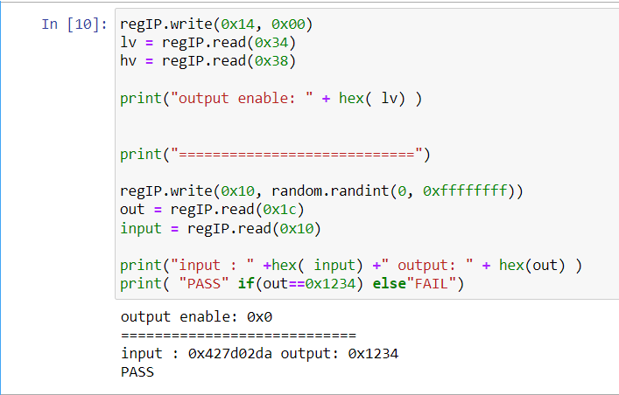

Slide 12
End

